Slide 1
Graphics Applets
By
Mr. Dave Clausen

Slide 2
Applets
A Java application is a stand-alone program with a main method (like the ones we've seen so far)
A Java applet is a program that is intended to transported over the Web and executed using a web browser
An applet also can be executed using the Applet Viewer tool of the Java Software Development Kit
An applet doesn't have a main method
Instead an applet uses public void init()method
Applets can contain:
Methods you define
Variables and constants
Decisions, loops, and arrays

Slide 3
Create an Applet
Use JCreator to create the java and html codes
Write applet source code in Java
Save with .java file extension
Compile applet into bytecode
Write HTML document
Save with .html or .htm file extension
Include a statement to call the compiled Java class (.class)
To “run” the applet in JCreator
Compile the java code
Execute the html code to view the applet in the Applet Viewer
Or load HTML document into a Web browser
When you make changes, save the java code, recompile the java code, and refresh the browser.

Slide 4
Inheritance and bytecode
The class that defines an applet extends the Applet class
This makes use of inheritance.
An applet is embedded into an HTML file using a tag that references the bytecode (.class) file of the applet class
The bytecode version of the program is transported across the web and executed by a Java interpreter that is part of the browser

Slide 5
HTML Comments
Comments begin with <!- - (no spaces between)
Comments end with - ->
<!--********************************************************************
* *
* Mr. Clausen 9999 *
* *
* Program Move Circle Applet Animation *
* *
* AP Computer Science Java Period ? *
* *
* Starting Date: 5/?/200? Due Date: 5/?/200? *
* *
* This program will animate a circle in a Java Applet *
* Don't forget to include comments describing your applet and *
* what exactly it does. *
********************************************************************-->

Slide 6
HTML Template & applet Tag
<!DOCTYPE HTML PUBLIC "-//W3C//DTD HTML 4.01 Transitional//EN" "http://www.w3.org/TR/html4/loose.dtd">
<html>
<head>
<title>YourLastName FirstName ID# Final Project</title>
</head>
<body>
<center> <h3>YourLastName FirstName ID# Final Project</h3>
<applet code=“LastNameFirstNameFP.class" width=760 height=520>
</applet>
</center>
</body>
</html>
An HTML Template For Graphics Programs

Slide 7
Applet Class Methods
Our Java Source code public class needs to include extends Applet (for example)
public class MoveCircle extends Applet
Applet class methods Inherited from the Applet Class
Automatically Invoked by the Web browser when the browser runs the applet
These methods don’t have to be included in your applet unless you wish to override the methods in the parent class.
public void init()
public void start()
public void stop()
public void destroy()

Slide 8
Applet method Execution
init() method
Executes when a Web page containing an Applet is loaded
Or when running appletviewer command
start() method
Executes after init() method
Executes again every time the applet becomes active after it has been inactive
stop() method
Invoked when user leaves Web page
destroy() method
Called when user closes browser or Applet Viewer
Releases any resources Applet might have allocated

Slide 9
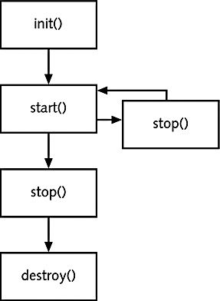
Applet Life Cycle

Slide 10
Overriding applet Methods
Overriding a method means
Replace original version (the inherited version)
Advanced programmers may choose to override the stop () and destroy () methods
We will not override them
We will override the init () method
To resize our applet
To set the background color
For example:
public void init()
{
//Set the size of the applet panel
resize(760, 520);
setBackground (Color.white);
}

Slide 11
Additional Applet Methods
There are nearly 200 additional methods
Manipulate components within Japplets or Applets
We are not using applet components in our programs
Components include
Buttons
Labels and
Text Fields
Read definitions at http://java.sun.com Web site

Slide 12
Applet paint Method
There are several other special methods that serve specific purposes in an applet.
The paint method, for instance, is executed automatically and is used to draw the applet’s contents
The paint method accepts a parameter that is an object of the Graphics class
public void paint(Graphics g)
A Graphics object defines a graphics context on which we can draw shapes and text
The Graphics class has several methods for drawing shapes

Slide 13
paint()Method
paint() method
Runs when Java displays the applet
We will write own method to override the default method
Executes automatically every time someone
Minimizes, maximizes, or resizes Applet Viewer window or browser window
Method header
public void paint(Graphics g)

Slide 14
Drawing Shapes
Let's explore some of the methods of the Graphics class that draw shapes in more detail
A shape can be filled or unfilled, depending on which method is invoked
The method parameters specify coordinates and sizes
Recall that the Java coordinate system has the origin in the top left corner
Shapes with curves, like an oval, are usually drawn by specifying the shape’s bounding rectangle
An arc can be thought of as a section of an oval

Slide 15
Coordinate Systems
Each pixel can be identified using a two-dimensional coordinate system
When referring to a pixel in a Java program, we use a coordinate system with the origin in the top-left corner
(0, 0)
112
X
40
(112, 40)
Y

Slide 16
Drawing a Line
10
150
X
20
45
Y
g.drawLine (10, 20, 150, 45);
or
g.drawLine (150, 45, 10, 20);

Slide 17
Drawing a Rectangle
50
X
20
40
100
Y
g.drawRect (50, 20, 100, 40);

Slide 18
Drawing an Oval
175
X
20
80
bounding
rectangle
Y
50
g.drawOval (175, 20, 50, 80);

Slide 19
Drawing a Polygon
drawPolygon(int[ ] xPoints, int[ ] yPoints, int nPoints)
Draws a closed polygon defined by arrays of x and y coordinates.
fillPolygon(int[ ] xPoints, int[ ] yPoints, int nPoints)
Fills a closed polygon defined by arrays of x and y coordinates.
fillPolygon example
HTML file
Java file
public class DrawPolygon extends Applet {
int[ ] xPoints = {10, 80, 10, 10};
int[ ] yPoints = {120, 160, 200, 120};
. . .
public void paint (Graphics g) {
g.setColor (Color.orange);
g.fillPolygon (xPoints,yPoints,4);
}

Slide 20
Shape Methods Summary
clearRect(int x, int y, int width, int height) Clears the specified rectangle by filling it with the background color of the current drawing surface.
draw3DRect(int x, int y, int width, int height, boolean raised) Draws a 3-D highlighted outline of the specified rectangle.
drawArc(int x, int y, int width, int height, int startAngle, int arcAngle) Draws the outline of a circular or elliptical arc covering the specified rectangle.
drawLine(int x1, int y1, int x2, int y2) Draws a line, using the current color, between the points (x1, y1) and (x2, y2) in this graphics context's coordinate system.
drawOval(int x, int y, int width, int height) Draws the outline of an oval.
drawPolygon(int[] xPoints, int[] yPoints, int nPoints) Draws a closed polygon defined by arrays of x and y coordinates.
drawPolygon(Polygon p) Draws the outline of a polygon defined by the specified Polygon object.
drawRect(int x, int y, int width, int height) Draws the outline of the specified rectangle.
drawRoundRect(int x, int y, int width, int height, int arcWidth, int arcHeight) Draws an outlined round-cornered rectangle using this graphics context's current color.
drawString(String str, int x, int y) Draws the text given by the specified string, using this graphics context's current font and color.

Slide 21
Shape Methods Summary 2
drawString(String str, int x, int y) Draws the text given by the specified string, using this graphics context's current font and color.
fill3DRect(int x, int y, int width, int height, boolean raised) Paints a 3-D highlighted rectangle filled with the current color.
fillArc(int x, int y, int width, int height, int startAngle, int arcAngle) Fills a circular or elliptical arc covering the specified rectangle.
fillOval(int x, int y, int width, int height) Fills an oval bounded by the specified rectangle with the current color.
fillPolygon(int[] xPoints, int[] yPoints, int nPoints) Fills a closed polygon defined by arrays of x and y coordinates.
fillPolygon(Polygon p) Fills the polygon defined by the specified Polygon object with the graphics context's current color.
fillRect(int x, int y, int width, int height) Fills the specified rectangle.
fillRoundRect(int x, int y, int width, int height, int arcWidth, int arcHeight) Fills the specified rounded corner rectangle with the current color.

Slide 22
Drawing Arcs
drawArc() method arguments
x-coordinate of upper-left corner of imaginary rectangle that represents bounds of imaginary circle that contains arc
y-coordinate of same point
Width of imaginary rectangle that represents bounds of imaginary circle that contains arc
Height of same imaginary rectangle
Beginning arc position
Arc angle
drawArc(int x, int y, int width, int height, int startAngle, int arcAngle)
Draws the outline of a circular or elliptical arc covering the specified rectangle.

Slide 23
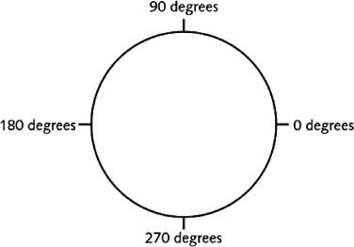
Arc Angles

Slide 24
fillArc method
fillArc() method
Creates a solid arc
Two straight lines are drawn from the arc endpoints to the center of an imaginary circle whose perimeter the arc occupies.
fillArc(int x, int y, int width, int height, int startAngle, int arcAngle)
Fills a circular or elliptical arc covering the specified rectangle

Slide 25
Polygons
drawPolygon() method
Draws complex shapes
Requires three arguments
An integer array that holds the x-coordinate positions
A second array that holds the corresponding y-coordinate positions
The number of pairs of points to connect
drawPolygon(int[ ] xPoints, int[ ] yPoints, int nPoints)
Draws a closed polygon defined by arrays of x and y coordinates.

Slide 26
fillPolygon Method
fillPolygon() method
Draws a solid shape
If the beginning and ending points are not identical
The two endpoints will be connected by a straight line before polygon is filled with color
fillPolygon(int[] xPoints, int[] yPoints, int nPoints)
Fills a closed polygon defined by arrays of x and y coordinates.

Slide 27
clearRect method
clearRect(int x, int y, int width, int height)
Clears the specified rectangle by filling it with the background color of the current drawing surface.
Appears empty or “clear”
We can use clearRect to erase individual items or the entire background scene if your animation has more than one background scene
Much like the way we used cleardevice( ) in C++

Slide 28
Color
A Java programmer can control the color of images by using the Color class.
The Color class is included in the package java.awt.
The Color class provides the class constants shown in Table 19-2.
The Graphics class includes two methods for examining and modifying an image's color (Table 19-3).

Slide 29
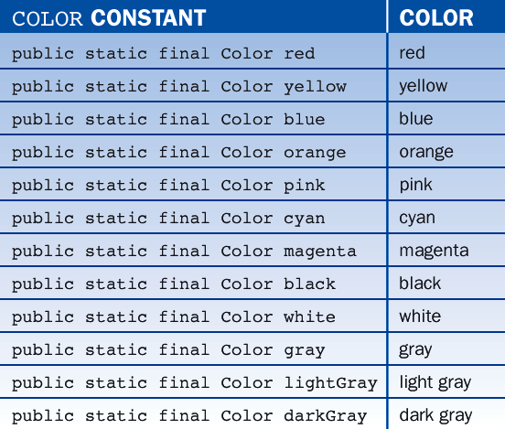
Color Constants
Table 19-2: Color Class Constants

Slide 30
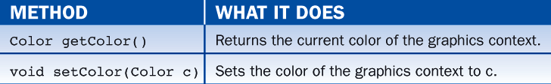
Color Methods
The Graphics class includes two methods for examining and modifying an image's color
(Table 19-3)
Using a predefined color
g.setColor (Color.red); // red is a method of the color class

Slide 31
Create Your Own Colors
Every color can be represented as a mixture of the three additive primary colors Red, Green, and Blue
In Java, each color is represented by three numbers between 0 and 255 that collectively are called an RGB value
A color is defined in a Java program using an object created from the Color class

Slide 32
The Color Class
The Color class contains several static predefined colors. Here are a few of the color constants with their RGB values.
Object
Color.black
Color.blue
Color.cyan
Color.orange
Color.white
Color.yellow
RGB Value
0, 0, 0
0, 0, 255
0, 255, 255
255, 200, 0
255, 255, 255
255, 255, 0

Slide 33
How To Create Your Own Colors
Java allows the programmer more refined control over colors by using RGB (red/green/blue) values.
In this scheme, there are:
256 shades of red
256 shades of green
256 shades of blue
The programmer "mixes" a new color by selecting an integer from 0 to 255 for each color and passing these integers to a Color constructor as follows:
new Color (<int for red>, <int for green>, <int for blue>)

Slide 34
Create Random Colors
The next code segment shows how to create a random color with RGB values:
// Create a random color from randomly generated RGB values
int r = (int) (Math.random() * 256);
int g = (int) (Math.random() * 256);
int b = (int) (Math.random() * 256);
Color randomColor = new Color (r, g, b);

Slide 35
Custom Color Examples
Examples of creating and instantiating custom colors
Color myGreen = new Color (0, 204, 0);
Color myPurple = new Color (153, 0, 150);
Color myBrown = new Color (166, 124, 82);
Color myOrange = new Color (251, 136, 93);
Using a predefined color
g.setColor (Color.red); // red is a method of the color class
Using your custom color
g.setColor (myGreen);

Slide 36
The Color Class
Every drawing surface has a background color
setBackground (Color.white);
Every graphics context has a current foreground color
g.setColor (Color.blue);
Both can be set
See Snowman.java and Snowman.html
Before starting animation, experiment with drawing shapes in a “still life” using Snowman.java as an example in a “paint” method.

Slide 37
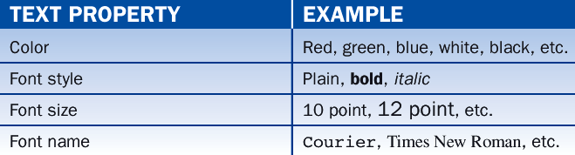
Text Properties
A text image has several properties, as shown in Table 19-8 below.
These are set by adjusting the color and font properties of the graphics context in which the text is drawn.

Slide 38
Text Properties
The Font Class
An object of class Font has three basic properties:
a name
a style
and a size
The following code creates one Font object with the properties Courier bold 12 and another with the properties Arial bold italic 10:
Use descriptive names for your fonts as illustrated below.
Font courierBold12 = new Font("Courier", Font.BOLD, 12);
Font arialBoldItalic10 = new Font("Arial", Font.BOLD + Font.ITALIC, 10);

Slide 39
Text Properties
The Font constants PLAIN, BOLD, and ITALIC define the font styles.
The font size is an integer representing the number of points, where one point equals 1/72 of an inch.
The available font names depend on your particular computer platform.
To see what they are, run the code segment:
String fontNames[] = Toolkit.getDefaultToolkit().getFontList();
int i;
for (i = 0; i < fontNames.length; i++)
System.out.println (fontNames[i]);

Slide 40
Text Properties
The code:
Declares the variable fontNames as an array of strings.
Runs the Toolkit class method getDefaultToolkit, which returns the default toolkit for the particular computer platform.
Runs the method getFontList on the toolkit. This method returns a list of the available font names.
Sets the array fontNames to this list.
Executes a loop that displays the contents of fontNames in the terminal window.

Slide 41
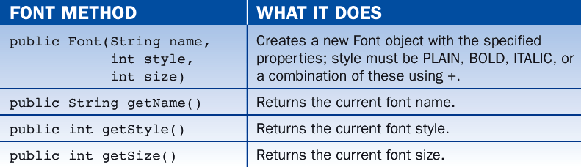
Text Properties
Table 19-9 lists the principal font methods:

Slide 42
Text Properties
Setting the Color and Font Properties of Text
Assume that we want to display the text "Hello world!" in green with the font Courier bold 14. The following code would do this:
Changing the font and color of a graphics context affects all subsequent graphics operations in that context but does not alter the font or color of existing images.
Font courierBold14= new Font ("Courier", Font.BOLD, 14);
Color myGreen= new Color(0, 255, 0);
g.setColor (myGreen);
g.setFont (courierBold14);
g.drawString ("Hello world!", 100, 100);

Slide 43
Applet Methods Review
In previous examples we've used the paint method of the Applet class to draw on an applet
The Applet class has several methods that are invoked automatically at certain points in an applet's life
The init method, for instance, is executed only once when the applet is initially loaded
The start and stop methods are called when the applet becomes active or inactive
The Applet class also contains other methods that generally assist in applet processing

Slide 44
repaint() Method
repaint() method
We don’t call the paint() method directly.
We call the repaint() method when the window needs to be updated, perhaps with new images.
The repaint() method calls another method named update() which in turn calls the paint() method.
Creates Graphics object

Slide 45
Graphical Objects
Any object we define by writing a class can have graphical elements
The object must simply obtain a graphics context (a Graphics object) in which to draw
An applet can pass its graphics context to another object just as it can any other parameter
See LineUp.java
See StickFigure.java
See LineUp.html

Slide 46
Animations
An animation is a series of images that gives the appearance of movement (24 frames per second)
To create the illusion of movement, we use a timer to change the scene after an appropriate delay
private final int SLEEP_TIME = 10; //milliseconds
//delay
try
{
Thread.sleep(SLEEP_TIME);
}
catch(InterruptedException e)
{
}

Slide 47
Sources
Java Software Solutions
by Lewis and Loftus
Addison-Wesley
Fundamentals of Java Second Edition
by Lambert and Osborne
South-Western
Java Programming (versions 1, 2, & 4)
by Joyce Farrell
Thomson

