Slide 1

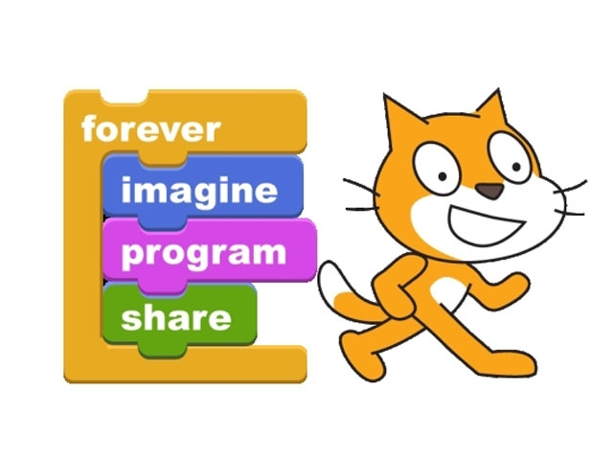
Introduction to

Slide 2
What is Scratch?
Scratch is a visual programming language
Scratch was developed by the Massachusetts Institute of Technology’s Media Group
Scratch is currently maintained and developed by MIT’s Media Group in collaboration with the UCLA Graduate School of Education and Information Studies.
Scratch is often used as an introductory programming language
Scratch builds on Logo
Some of the skills learned in Scratch can be applied to other programming languages like JAVA and Python.

Slide 3
Think of Scratch as a Theater Production
Think of the Scratch screen as a theater production with the following areas and characters.
  The Stage is where the action or scenes play out
  A Sprite is a character or actor. A cat is the default sprite. You will learn to change sprites and create custom sprites as we move forward
  The toolbox contains color coded blocks that control sprites and what occurs on stage.
  There are three tabs, Scripts, Costumes and Sounds.
  Programs that control the scenes are created by dragging blocks into the script area.

Slide 4
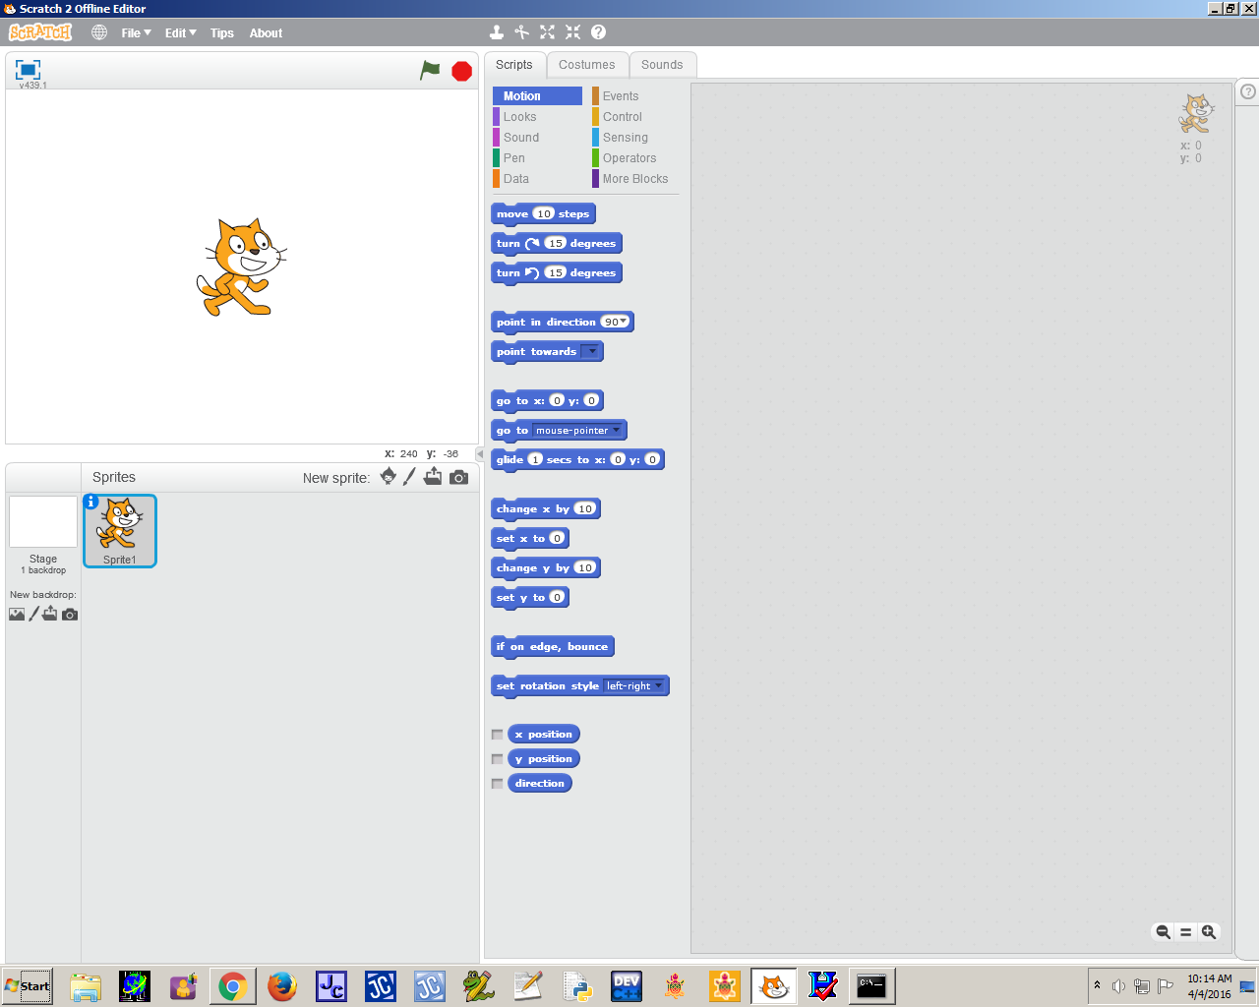
Stage
Script
Sprites
Toolbox with blocks

Slide 5
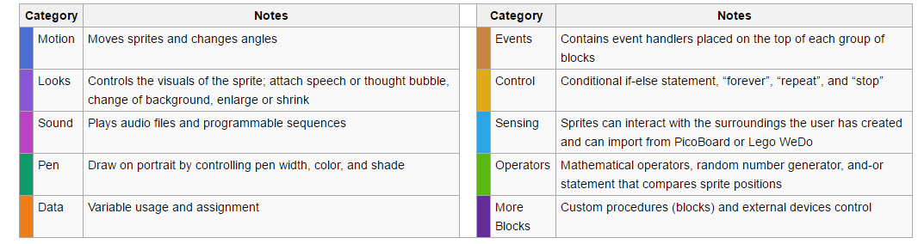
Programming blocks grouped and color coded by what functions they control.

Slide 6
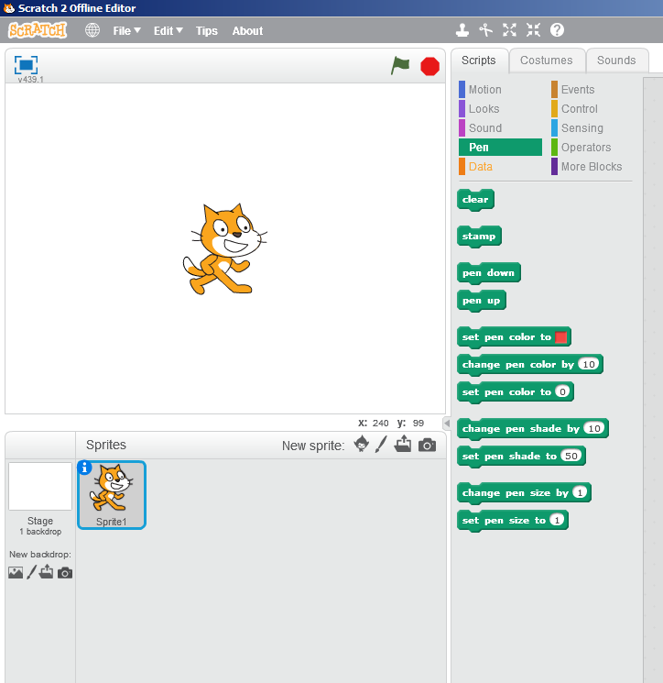
Pen Blocks (Green)
Commands are similar to Logo
Pen up and pen down blocks work just like the Logo commands
Clear removes prior pen marks
There are also blocks that allow you to change pen color and size just like Logo

Slide 7
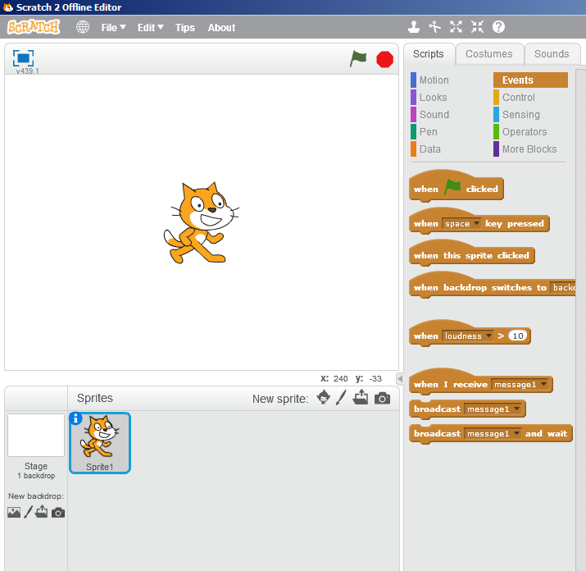
Event Blocks
Event blocks control when actions begin for particular sprites
Clicking on the green flag is how most scenes begin
As we gain a better understanding of Scratch, we will use other Event Blocks

Slide 8

Motion Blocks
Motion blocks move or turn Sprites on the stage
Many of the motion blocks will move sprites based on their location on the stage (relative motion)
Use negative numbers to move the Sprites backwards

Slide 9
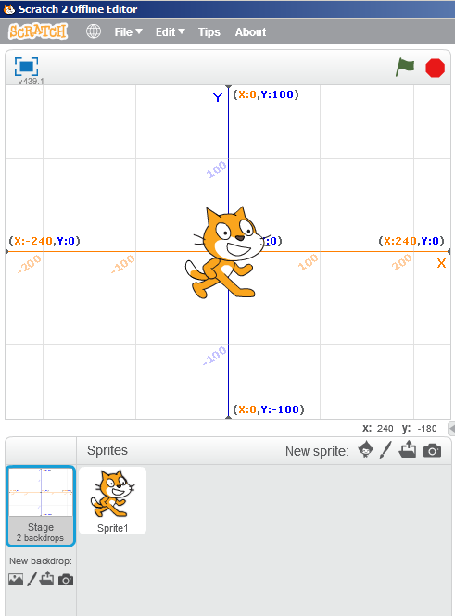
Absolute Motion
The Stage is set up on a coordinate plane (480 by 360, can’t change)
Every point on the Stage has a x and y coordinate that appear in the lower right of the stage
The coordinates of the center point on the Stage are (0,0)
Motion blocks that move Sprites to a specific position on the stage (x and y coordinate) regardless of the current position use absolute motion
Shows x and y coordinates of the curser position over the Stage

Slide 10
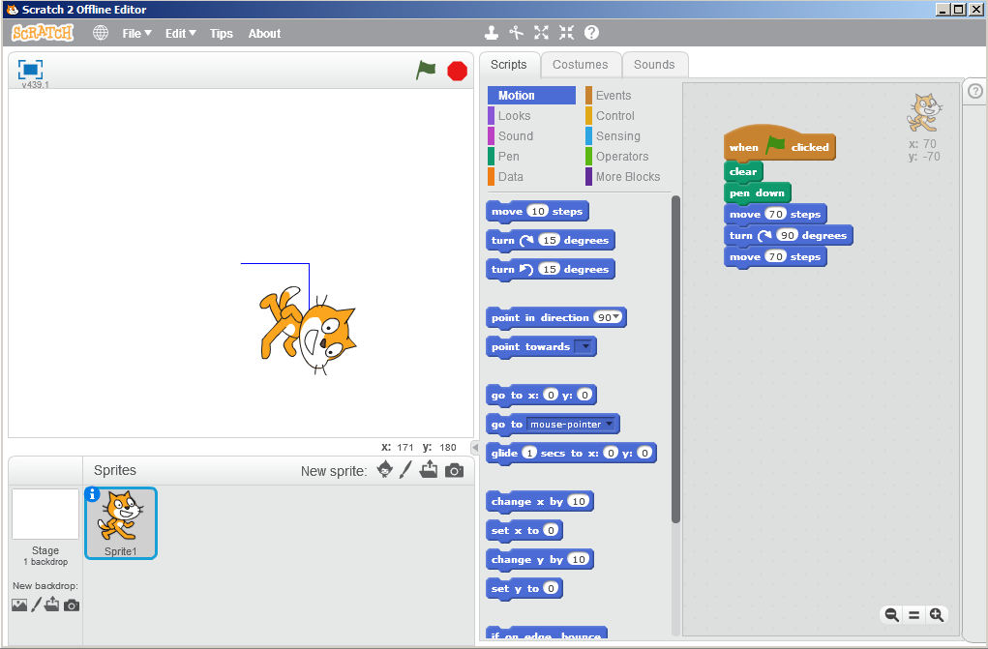
Writing a Program with Scratch
Writing programs in Scratch involves dragging specific blocks from the toolbox to the script area for each sprite
Connected blocks work together to control Sprites
Blocks that are NOT connected, won’t run when the green flag is clicked
Program
Script Area

Slide 11
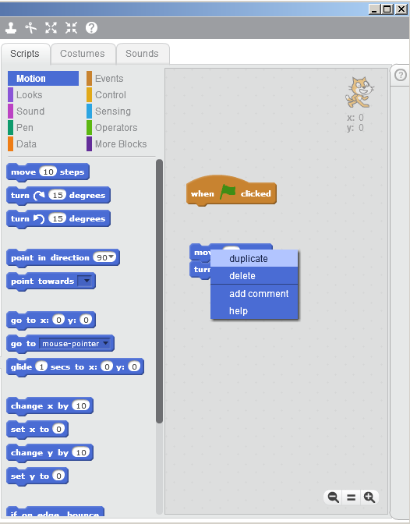
Duplicating Commands
There are occasions when we want a command to occur again.
By right clicking, we can duplicate command blocks.
Duplicating command blocks is fairly simple when we only want a command to repeat once or twice.
Duplicating command blocks is not effective for repeating commands multiple times.

Slide 12
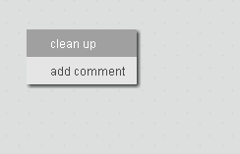
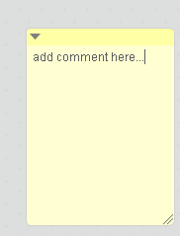
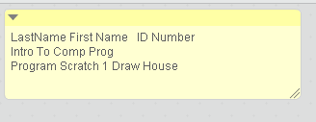
Creating Opening Comments in Scratch
You can create opening comments or comments that explain a section of code.
To create opening comments, right click on an empty spot at the top of the script area and choose “Add Comment” from the pop up menu.
Replace the words “add comment here” with comments
required for this class.
Change the size of the comment box by “dragging” the bottom right corner of the comment.

Slide 13
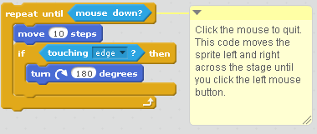
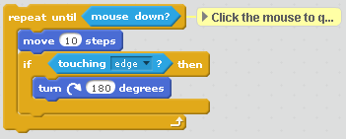
Creating Comments To Explain Your Code
To create comments to explain a section of code, right click on the line of code at the top of the code section that you wish to explain, and choose “Add Comment” from the pop up context menu.
Replace the words “add comment here” with comments
to explain your section of code.
You can “collapse” or expand the comment by clicking on the triangle in the top left corner of the comment box.

