Slide 1
Scratch: iteration / repetition / loops
by
Mr. Dave Clausen

Slide 2
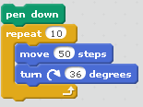
Iteration (Repetition) - Repeat Command
Iteration is computer programming jargon for repeating a section or group of lines of code. It is also called referred to as repetition.
Each time the code is executed (repeated) once is called one iteration.
The first type of repeat command in scratch is the same as we learned in LOGO. Repeat the section of code a specified number of times.
In this example, whatever code is contained inside this repeat command is repeated 10 times.
This example will draw a decagon.

Slide 3
Iteration (Repetition) - Repeat UNTIL Command
Sometimes you don’t want to repeat code a predetermined number of times.
Instead you want to repeat until or while some condition is TRUE.
This can be accomplished using a “Repeat Until” block.
The “hexagon” shape after the word “until” means we need some type of condition to determine when the “loop” will stop.
What type of blocks can be used as conditions in the Repeat Until loop?

Slide 4
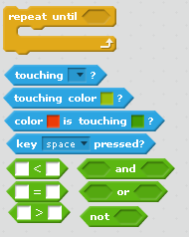
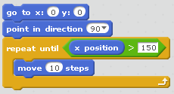
Conditionals for repeat until
We can find hexagonal shaped conditions under the Sensing (light blue) group and the Operators (green) group.
One of the easiest tasks we can do is to move the sprite until it reaches a certain position (see below).

Slide 5
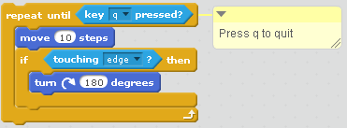
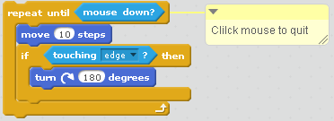
Conditionals for repeat until Continued
We can make something repeat until a key is pressed. In this example, “q” to quit. The second example will stop when the mouse is clicked.

Slide 6
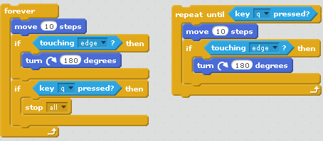
Repeat Forever
Avoid Repeat Forever whenever possible. Infinite loops are not a good idea.
Typically this type of loop requires an “if” statement to “break” out of the loop.
In the example below, it requires more lines of code to use a Repeat Forever loop than its equivalent Repeat Until loop.

