Slide 1


Sprites & Backdrops

Slide 2
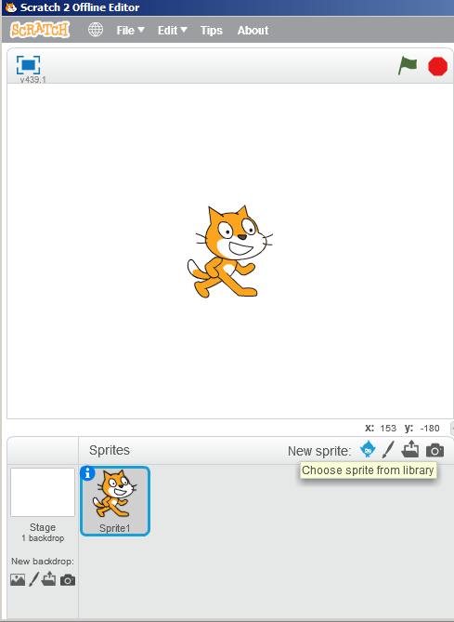
Sprites
Sprites are the actors that perform the commands in your script.
The cat is the default Sprite.
Scratch has many other Sprites you can use for your programs.
Click on the new Sprite button to see other Sprites.
Scratch also allows you to create/draw your own Sprites or download Sprites.
New Sprite button

Slide 3
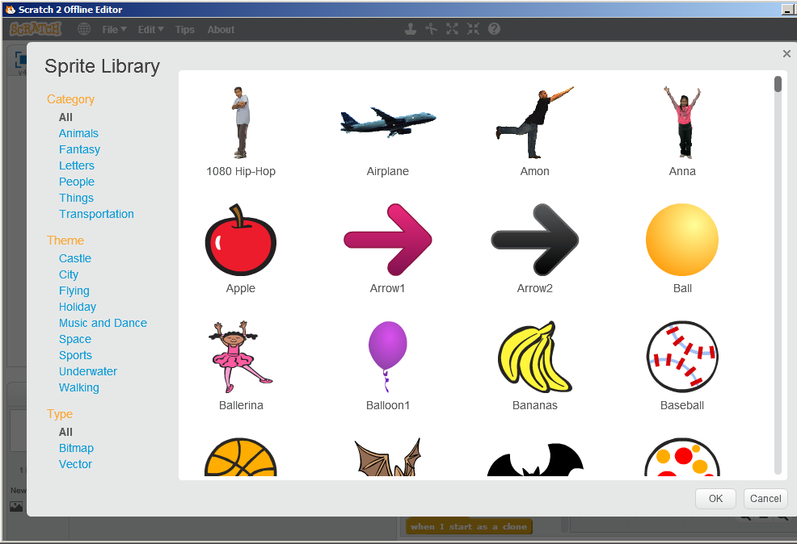

Slide 4
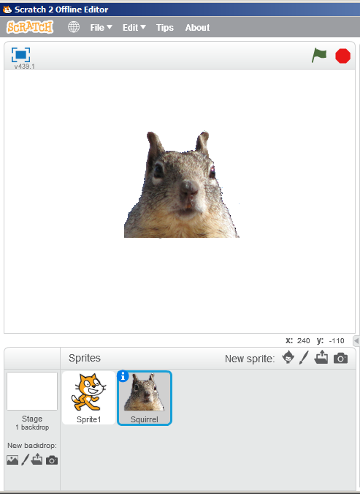
Adding Sprites
Double click on a Sprite from the sprite library you would like to use to add it to your program.
Programs can use multiple sprites.
Each sprite has its own script or commands.
Right click and select delete to get rid of sprites
You can also use the hide command from the “Looks” blocks if you don’t want a sprite to appear on the stage.

Slide 5
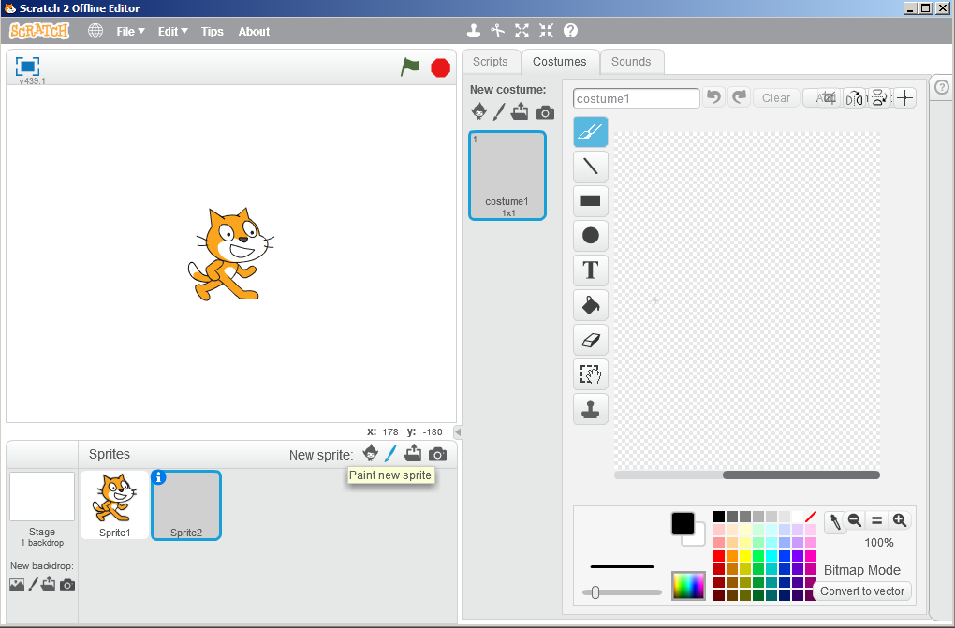
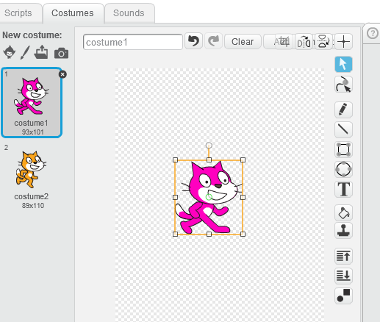
Painting Sprites
Sprites can be painted and altered in scratch.
Click on the Paint New Sprite Button or Costumes Tab to alter existing Sprites.
Use the Costumes Tab to alter Sprites
Painting Tools and workspace
Paint New Sprite Button

Slide 6
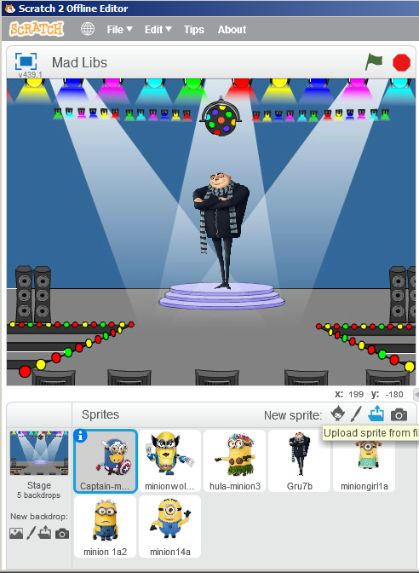
Uploading Sprites
Sprites can also be created by importing them.
Pictures from cameras can be also be used for new sprites.
The Costumes tab allows imported sprites to be altered in Scratch.
The cast of sprites and actors for your Scratch programs is endless.
Upload Sprite
New Sprite from Camera

Slide 7
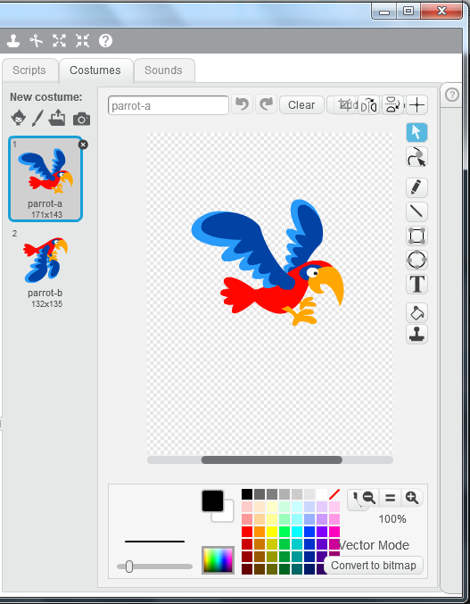
Sprite Costumes
Some Sprites may have multiple “Costumes.”
Costumes can help you create the illusion of motion and other effects on the stage.
Select a Sprite, then click on the costumes tab to see the available costumes for the sprite.

Slide 8
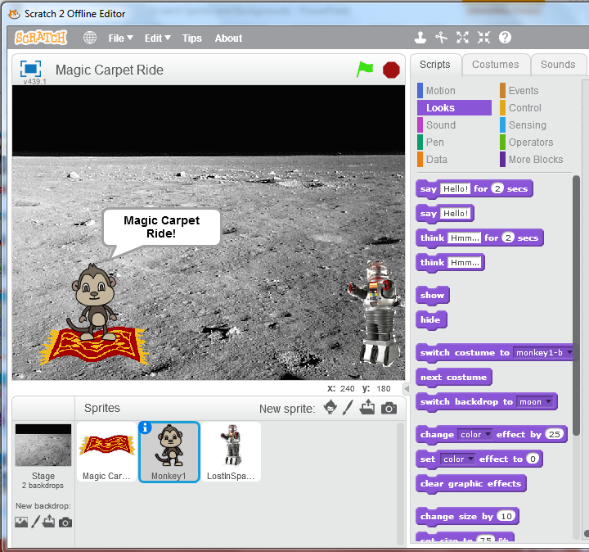
Sprite Can Speak
Allows Sprites to speak
Allows Sprites to convey what they are thinking.
In the “Look” toolbox there are blocks that allow sprites to visually speak and convey their thoughts.
These command blocks have are similar to what you would see in a comic book.

Slide 9
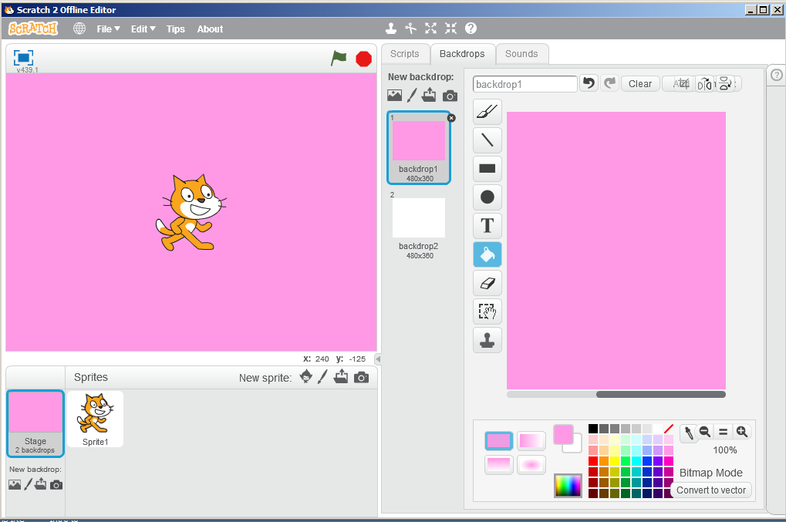
Backdrops
Paint New Backdrop
Backdrops Tab
By default, sprites appear against a white background.
Click on the Backdrops Tab to change the background color of the stage.
Tools in the Backdrops Tab allow you to create custom backdrops.
Use the paint bucket to fill the backdrop with color

Slide 10
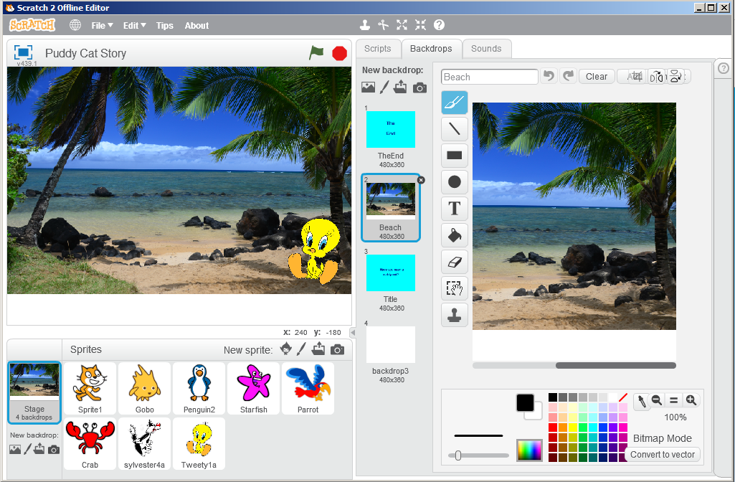
Pictures
New Backdrop from Camera
Backdrops Tab
Pictures can be imported from a camera or the internet and used as backdrops.
Click on Stage Backdrops in the lower left have the Backdrops Tab appear.
Click on the Backdrops Tab to customize.
Stage Backdrops

Slide 11
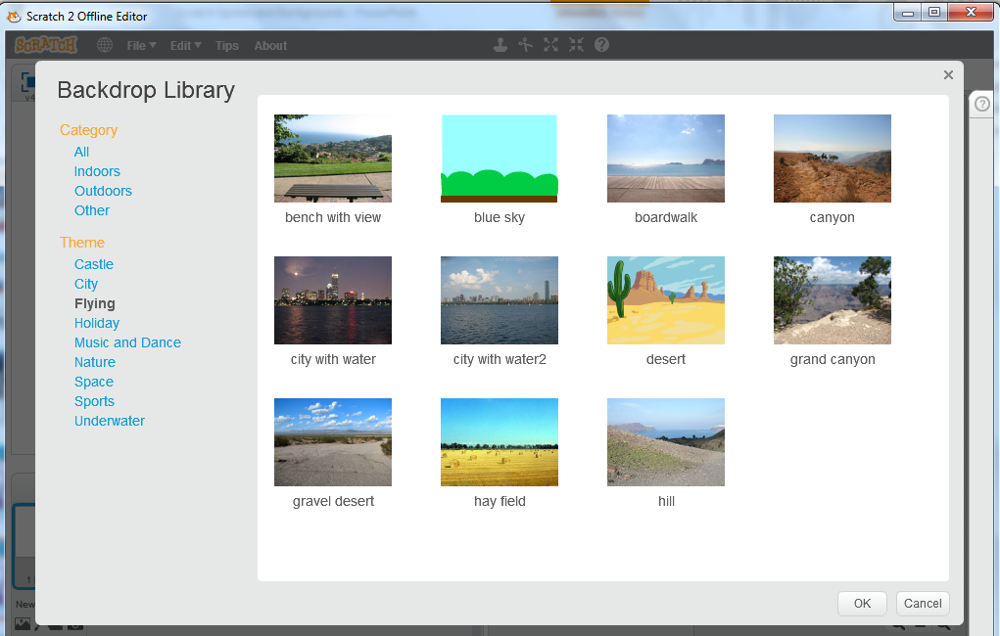
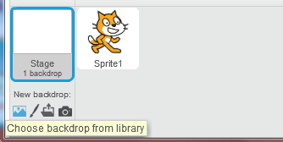
Backdrops Library
By default, sprites appear against a white background.
Click on the Backdrops Tab to change the background color of the stage.
Access Backdrop
Library

