Slide 1
Variables & getting info from the user
Mr. clausen

Slide 2
variables
A variable “names” a memory location in which information can be stored.
The stored information is referred to as the variable’s value.
During the course of a program, a variable’s value can be changed.
The variables name does not change.
It is customary to use all lowercase letters for a variable name unless the name is more than one word.
If the name is more than one word, capitalize the first letter of each word starting with the second word. This is called “camel case” (i.e. lengthSide).
Variable names cannot have spaces in their names.

Slide 3
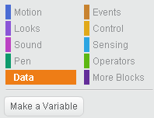
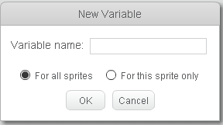
Creating variables in scratch
Click on the Data category, then click on the
“Make a Variable Button”.
In the dialog box that appears, give the variable
a good descriptive name (no one letter variable
names) that would describe what it represents
in the program.
Decide whether this variable should be
available to all sprites or just the current
sprite, and click “OK”.

Slide 4
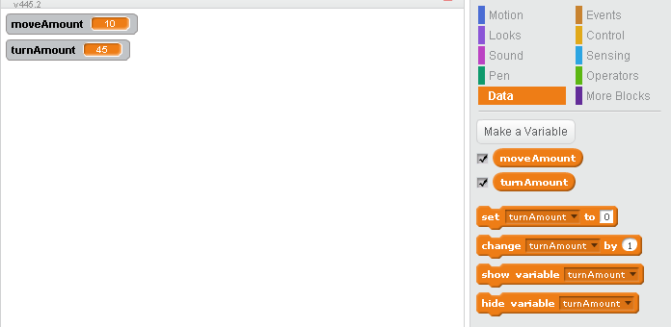
Scratch variables continued
Your variables appear below the “Make A Variable Button”.
If the box next to
the variable name
is checked, the
values of your
variables will
appear in the top
left corner of the
stage.

Slide 5

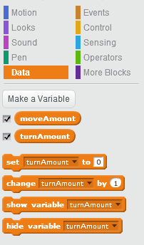

Getting input from the user
From the Sensing (light blue) section of commands, use the “ask and wait” command.
From the Data command list, use the “set to” command.
Pair these commands together as shown below, using
the “answer” button from the Sensing menu.
“Set to” has a drop down menu to select which variable
to use (you need to create the variable first).

Slide 6
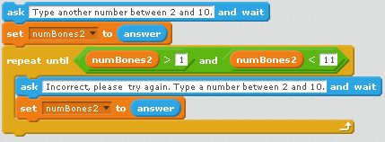
error trapping a numeric range
After getting input from the user, we can use a Repeat Until statement to “error trap” the input (check for valid input within an acceptable range). Remember, “and” means BOTH conditions must be met.
Ask the user for input first. Then check if the input is within the expected range in the condition of a Repeat Until. Give the user feedback if the input is not within the
range, and
ask the user for the
information again
in the “body” of the
repeat until
loop.

Slide 7
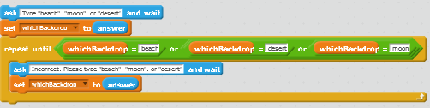
error trapping text response
After getting input from the user, we can use a Repeat Until statement to “error trap” the input to see if the user entered the text we requested. Remember, “or” means if one or more is true, the whole expression is true.
ChooseBackdrop.sb2

